Slide 1
Digital Portfolio
STUDENT NAME: B. HEMAVATHI
REGISTER NO AND NMID: astvu30430424u09009
DEPARTMENT: BCA
COLLEGE: COLLEGE/ UNIVERSITY: Arignar Anna Government Arts And Science College Walajapet, Thiruvalluvar University

Slide 2
PROJECT TITLE
Architecture
Portfolio

Slide 3


AGENDA
Problem Statement
Project Overview
End Users
Tools and Technologies
Portfolio design and Layout
Features and Functionality
Results and Screenshots
Conclusion
Github Link
3/21/2024 Annual Review

Slide 4

PROBLEM STATEMENT
In the field of architecture, showcasing creativity, design process, and technical expertise is crucial for academic growth, career opportunities, and client engagement. Traditional resumes or paper-based portfolios often fail to capture the depth of architectural projects, 3D visualizations, and design thinking. Many students and professionals lack a well-structured and visually appealing portfolio that effectively communicates their skills, concepts, and achievements. An interactive and organized architecture portfolio provides a comprehensive platform to present academic projects, professional works, design philosophies, and accomplishments in a clear and engaging manner.

Slide 5

PROJECT OVERVIEW
My architecture portfolio is a comprehensive showcase of my personal achievements, skills, and projects. It provides a glimpse into my professional journey, highlighting my expertise and experience in the field of architecture.
Portfolio Contain:-
About Me, Details, Education and Qualification, Hobbies,
Company, ID card, Skills, Projects, Designs,
. Certificate, Award, Contact .
Main Idea:
The main idea behind my portfolio is to showcase my personal achievements,
skills, and projects in a clear and concise manner. I aim to establish myself as a
competent and creative architect, and to attract potential clients, employers, or
collaborators. My portfolio is a reflection of my professional brand and values, and
I strive to continually update and improve it to reflect my growing experience and
expertise.

Slide 6

WHO ARE THE END USERS?
Potential Clients:
Looking for a reliable and skilled architecture firm to handle their projects, they want to see my expertise, design style, and completed projects.
Partners or Collaborators:
Other architects, designers, or professionals interested in collaborating on projects, who value my portfolio as a showcase of my skills and experience.
New Talent:
Recent graduates or experienced architects looking for job opportunities, who may be interested in my company's projects, culture, and values.
Industry Peers:
Other architecture firms or industry leaders who may be interested in my work, design approach, and company culture.
Awards and Recognition Committees:
Evaluating my portfolio for awards or recognition in the architecture field.

Slide 7

TOOLS AND TECHNIQUES
HTML → Structure (container, sections,link).
CSS → Styling (colors, layout, attractive).
JavaScript → Interactivity (form validation).
Code Editor → CODEPEN and hosting platform (GitHub Pages).

Slide 8
POTFOLIO DESIGN AND LAYOUT
Design and Layout
The design and layout of my architecture portfolio are carefully crafted to showcase my skills, experience, and projects in a clear and concise manner.
Header Section
*Navigation Menu*: A simple and intuitive navigation menu allows visitors to easily access different sections of the portfolio.
*Name and Title*: My name and title are prominently displayed in the header section.
Main Sections
*About Me*: A brief introduction to who I am, my background, and my passion for architecture.
*My Details*: Additional information about my experience, skills, and services offered.
*Education and Qualification*: A showcase of my academic credentials, including degrees and certifications.
*Architecture Related Hobbies*: A glimpse into my interests and hobbies outside of architecture that relate to the field.
*About My Company*: Information about my company, including its mission, values, and services offered.
*Company Website*: A link to my company's website for visitors who want to learn more.
8

Slide 9
Portfolio Showcase *My Projects*: A showcase of my notable projects, including images. *Project Images*: High-quality images of my projects, showcasing my design skills and attention to detail. *Company Design Links*: Links to my company’s design work, showcasing our expertise and capabilities.
Credentials and Recognition.
*ID Card*: A digital representation of my professional identity.
*Certificates*: A showcase of any notable certifications or training I have received.
*Awards*: A showcase of any awards or recognition I have received for my work.
Contact and Footer
*Contact Information*: A simple and easy-to-use contact form or email address allows visitors to get in touch with
me.
*Footer*: A clean and simple footer section includes any relevant copyright information, social media links, or other
secondary details.
Overall, the design and layout of my architecture portfolio are designed to be clean, modern, and easy to navigate, allowing visitors to quickly find the information they need and get a sense of my skills and experience as an architect.

Slide 10
FEATURES AND FUNCTIONALITY
Interactive Navigation - Smooth scroll, sticky navigation bar, and quick access to sections like About, Education, Skills, Projects, etc ...
Dynamic Project Showcase - Image galleries, 3D model embeds, and project descriptions displayed with hover effects.
Skills Visualization - Animated progress bars or charts to visually represent proficiency in tools (AutoCAD, Revit, SketchUp, etc.).
Downloadable Resume/Portfolio -Button to download CV in PDF format.
Interactive Contact Form - JavaScript-enabled form validation with email integration.
Animated Elements - Subtle transitions, hover effects, and scroll animations for a modern user experience.
Personalized ID Card Section - Digital card with photo, name, and quick info.

Slide 11
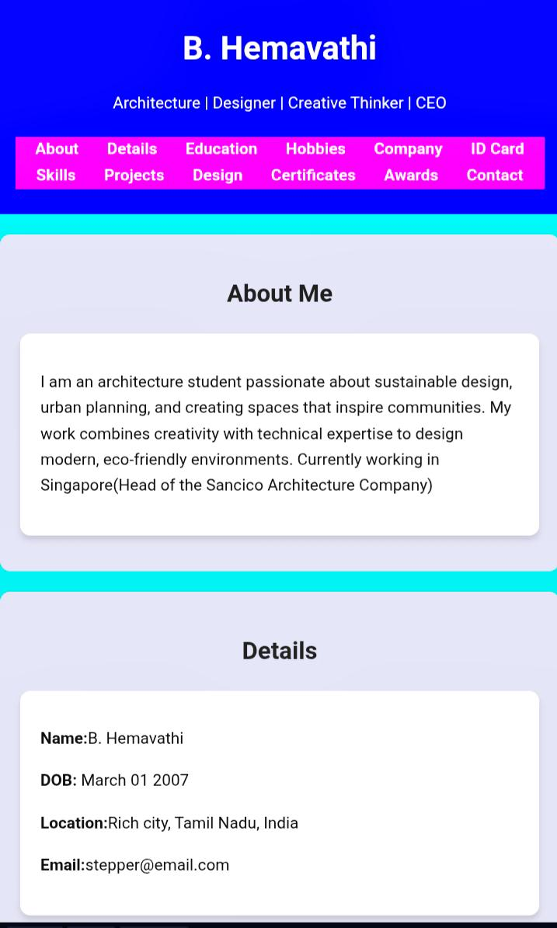

RESULTS AND SCREENSHOTS
“This architecture portfolio showcases creativity, technical skills, and design projects in a visually structured way.”
3/21/2024 Annual Review
11

Slide 12
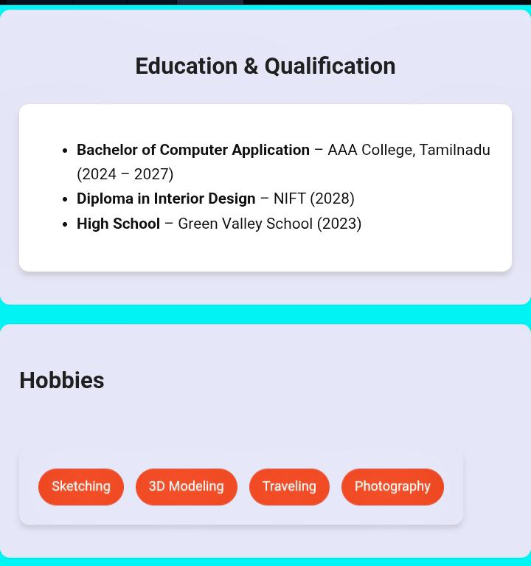
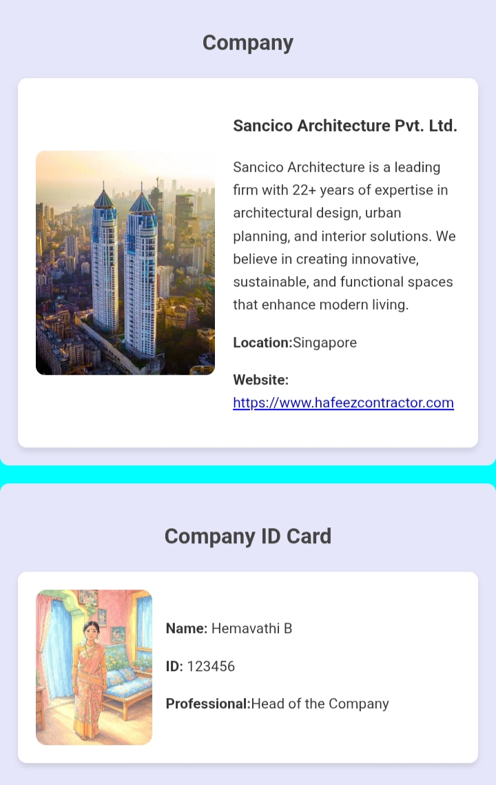

Slide 13
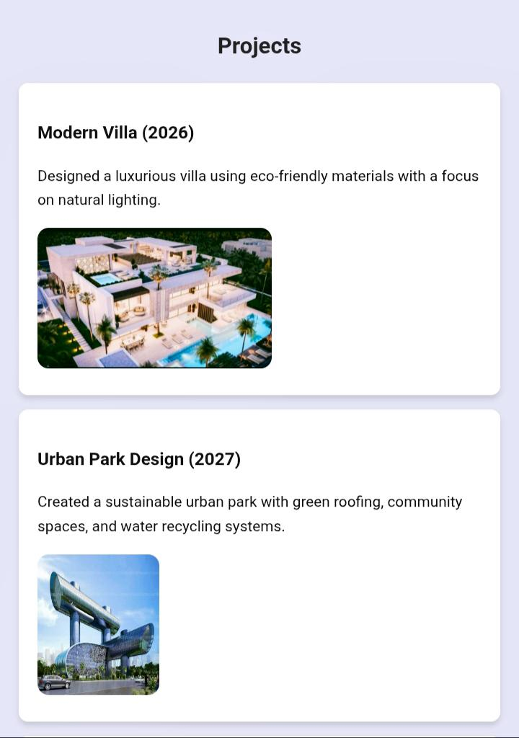
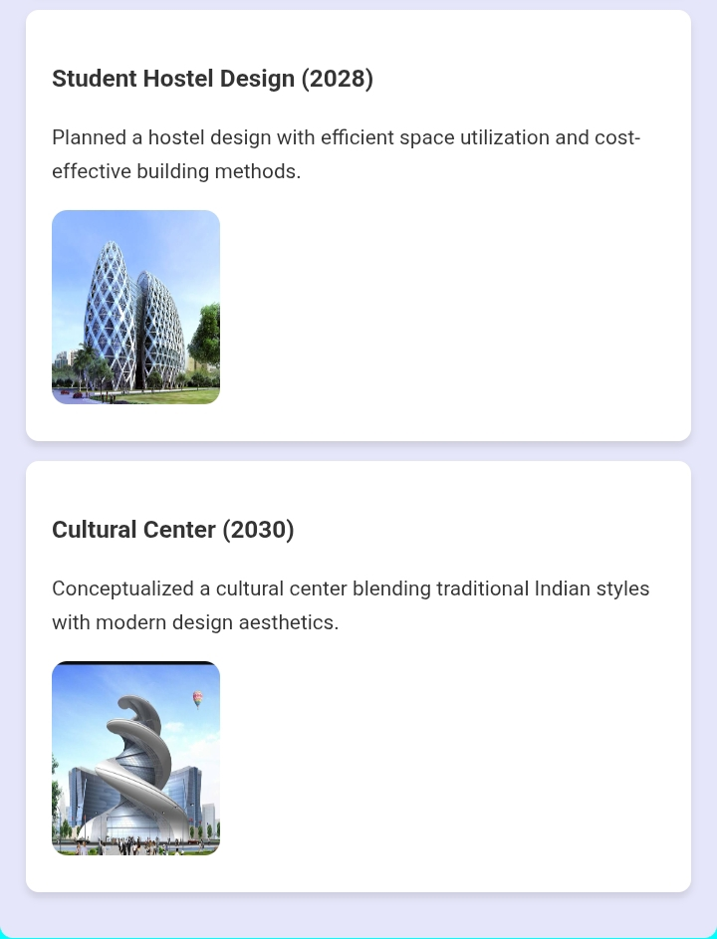

Slide 14
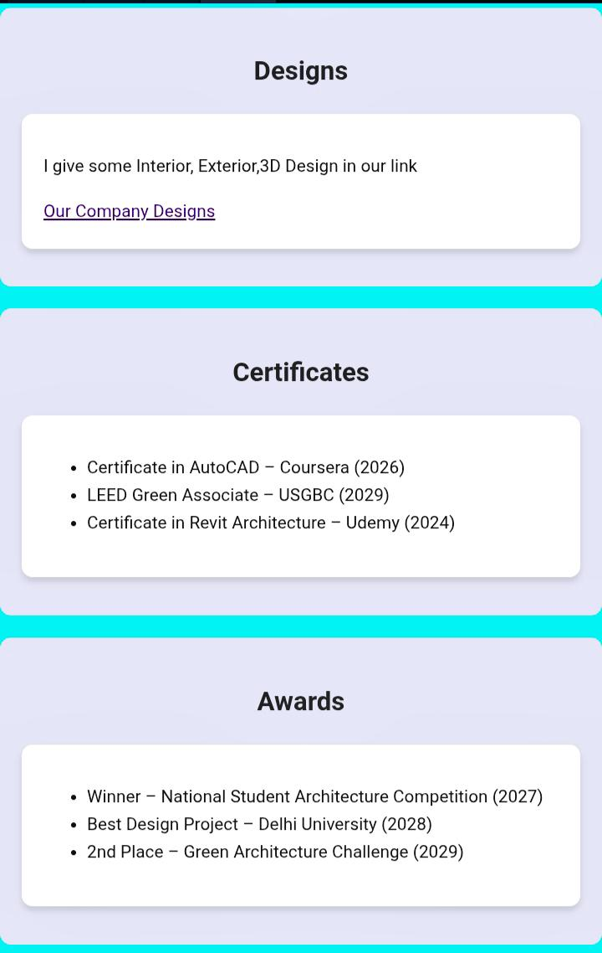
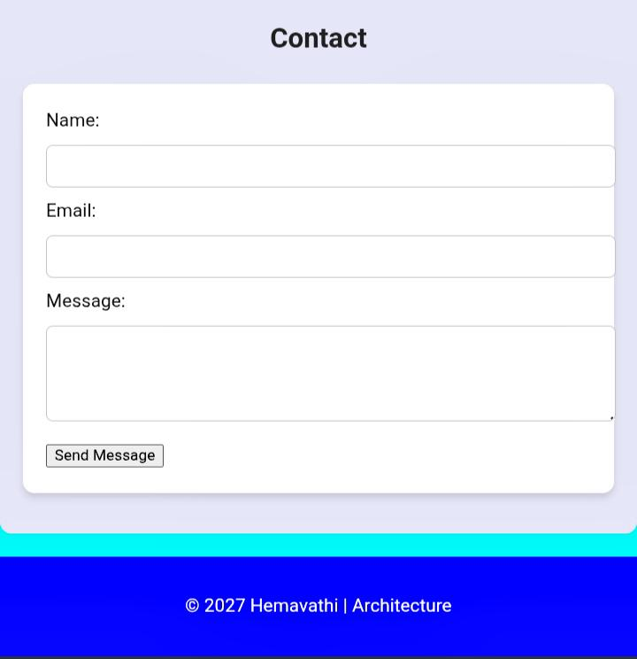

Slide 15
CONCLUSION
“Through this portfolio, I aim to showcase my passion for innovative design, technical expertise, and commitment to delivering exceptional architecture solutions that exceed client expectations."
15

Slide 16
Thank you
By Hemavathi

